Slide 1

Open-Source Intelligence
A Gentle Introduction
Anton Sobolev
UT Dallas
Data Science for Social Inquiry,
June 2023

Slide 2
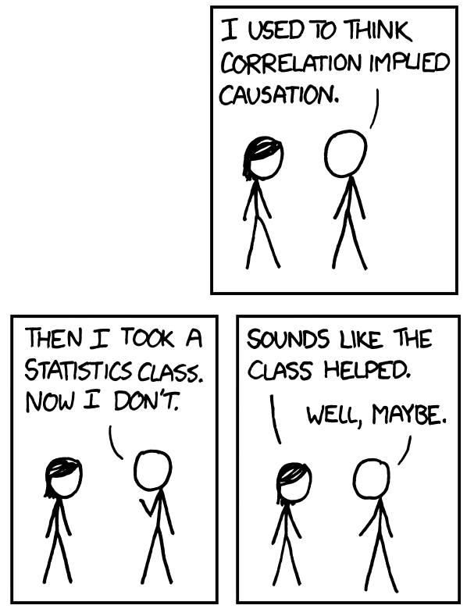
Social Inquiry Challenges: Causality & Data
How do we know: X ⟿ Y, not Y ⟿ X ?
☐ Causality
☐ Ice-Cream ⟿ Shark Attacks?
☐ Economic Growth ⟿ Democracy?
☐ Huge Progress
☐ Quasi-Experiments
☐ Causal Graphs:
Account for Alternatives
☐ Causality as Missing Data
☐ Main Factor of CI success
☐ Medical Studies!
Notes:
How evidence can inform the theory

Slide 3
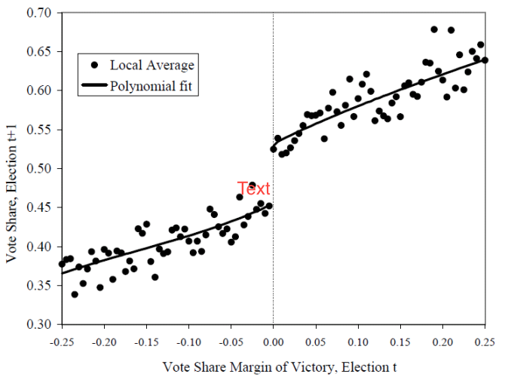
Social Inquiry Challenges: Causality & Data
How do we know: X ⟿ Y, not Y ⟿ X ?
☐ Causality
☐ Ice-Cream ⟿ Shark Attacks?
☐ Economic Growth ⟿ Democracy?
☐ Huge Progress
☐ Quasi-Experiments
☐ Causal Graphs:
Account for Alternatives
☐ Causality as Missing Data
☐ Main Factor of CI success
☐ Medical Studies!
Notes:
How evidence can inform the theory

Slide 4
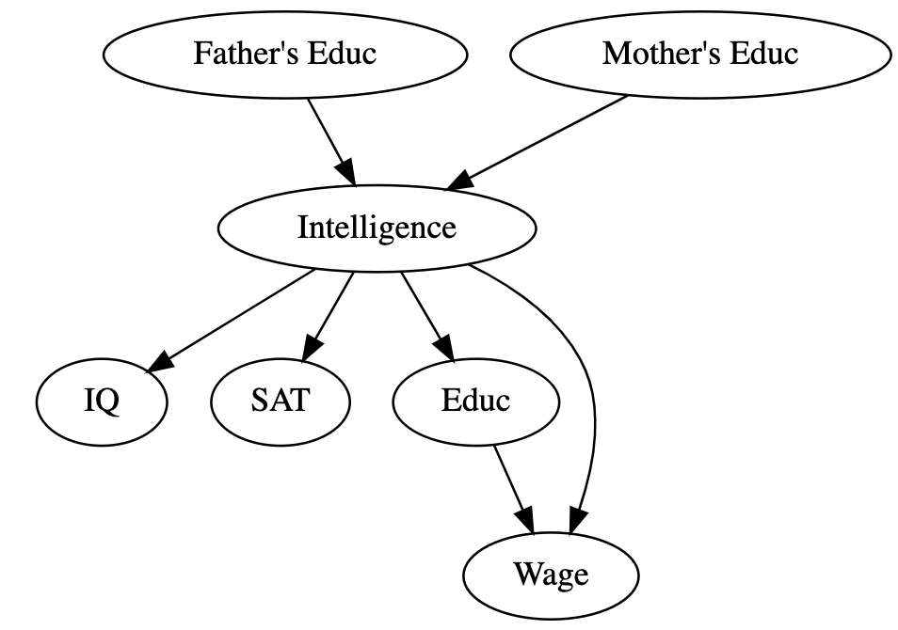
Social Inquiry Challenges: Causality & Data
How do we know: X ⟿ Y, not Y ⟿ X ?
☐ Causality
☐ Ice-Cream ⟿ Shark Attacks?
☐ Economic Growth ⟿ Democracy?
☐ Huge Progress
☐ Quasi-Experiments
☐ Causal Graphs:
Account for Alternatives
☐ Causality as Missing Data
☐ Main Factor of CI success
☐ Medical Studies!
Notes:
How evidence can inform the theory

Slide 5
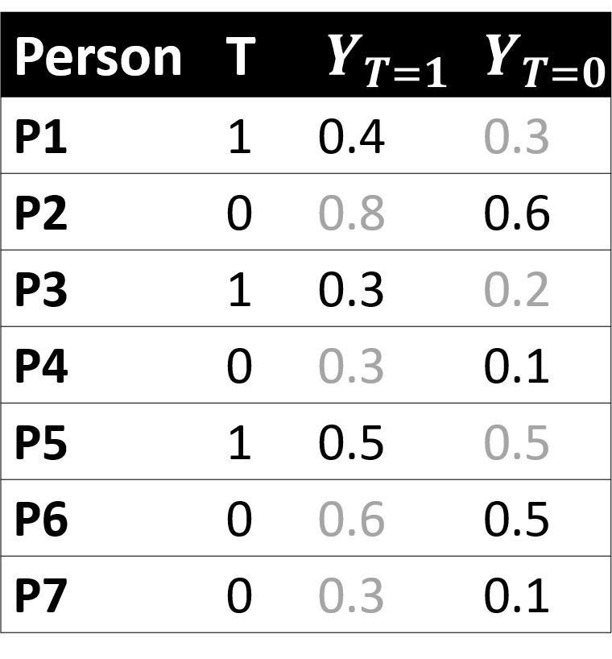
Social Inquiry Challenges: Causality & Data
How do we know: X ⟿ Y, not Y ⟿ X ?
☐ Causality
☐ Ice-Cream ⟿ Shark Attacks?
☐ Economic Growth ⟿ Democracy?
☐ Huge Progress
☐ Quasi-Experiments
☐ Causal Graphs:
Account for Alternatives
☐ Causality as Missing Data
☐ Main Factor of CI success
☐ Medical Studies!
Notes:
How evidence can inform the theory

Slide 6
Social Inquiry Challenges: Causality & Data
How the heck do we get data?
☐ Issue #1: Measurement
☐ Political Ideology
☐ Racism & Job Discrimination
☐ Media Bias
☐ Kid’s Trauma
☐ Anti-Dictator Attitudes
☐ Issue #2: Get Data
Old School
☐ Collected by someone: Public Statistics
☐ Created by yourself: Surveys
New School
☐ Auto-Generated: Social Media,
CCTV, Cellphones
New School is a part of of OSINT
Notes:
How evidence can inform the theory

Slide 7


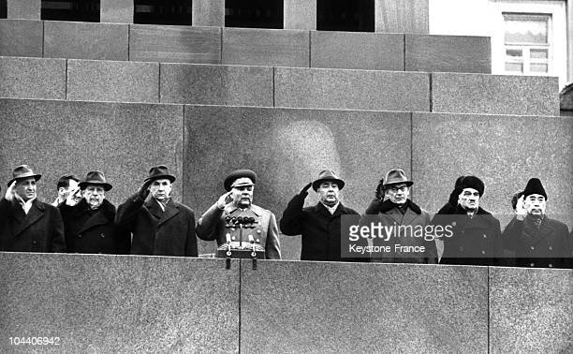
OSINT: Very-Very New Phenomena [well,almost]
☐ Kremlinology
☐ Soviet Statistics Lies
(China today?)
☐ Total Control: Spying is hard
[in contrast to soviet spies in the US]
Notes:
How evidence can inform the theory

Slide 8
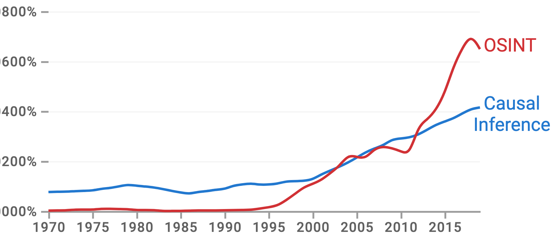

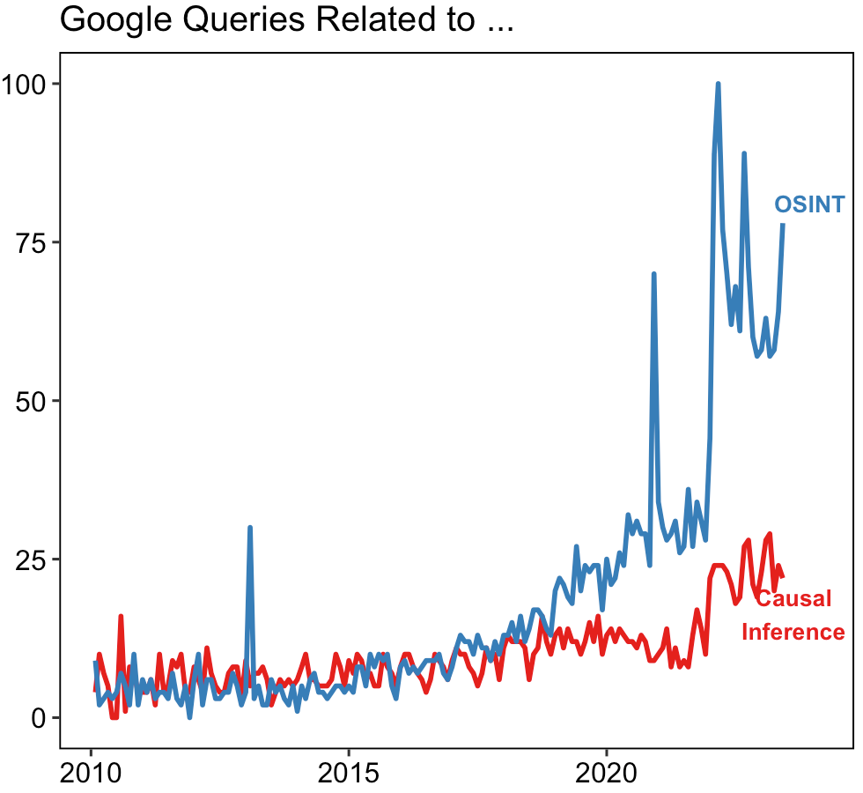

OSINT: Very-Very New Phenomena [well,almost]
Notes:
How evidence can inform the theory

Slide 9
OSINT Applications
☐ International Relations
☐ Open-Dat “Espionage”
☐ Military operations
☐ Anti-terrorism
☐ Corporate Sector:
☐ Competitive Intelligence (Uber)
☐ Market strategy
☐ Military operations
☐ Public Policy:
☐ Sensetive Issues (teenage pregnancy / racism / bullying )
☐ Criminal Investigations
☐ Crypto-investigations
good guys: “money laundering”
bad guys: “Repress donors of political opposition”
Notes:
How evidence can inform the theory

Slide 10
OSINT Applications
☐ International Relations
☐ Open-Dat “Espionage”
☐ Military operations
☐ Anti-terrorism
☐ Corporate Sector:
☐ Competitive Intelligence (Uber)
☐ Market strategy
☐ Military operations
☐ Public Policy:
☐ Sensetive Issues (teenage pregnancy / racism / bullying )
☐ Criminal Investigations
☐ Crypto-investigations
good guys: “money laundering”
bad guys: “Repress donors of political opposition”
And Social Sciences!
Notes:
How evidence can inform the theory

Slide 11
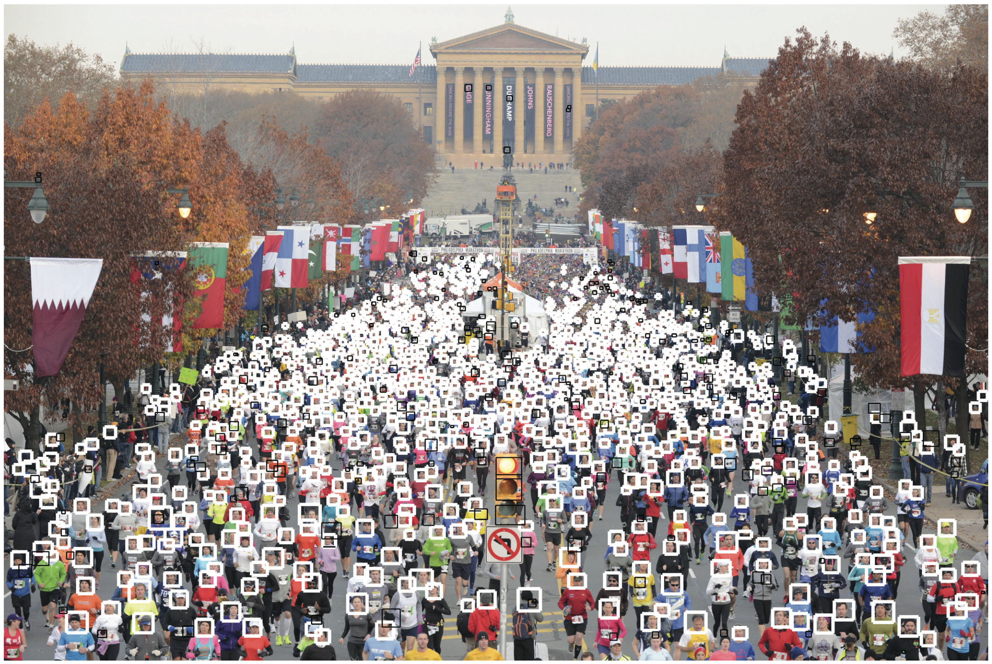
Get Data Exmple: Protest Behavior
☐ Old School
☐ Resoucres
☐ New school
☐ Understanding the case
☐ Data Generated around
Notes:
How evidence can inform the theory

Slide 12
Get Data Exmple: Protest Behavior
☐ Old School
☐ Resoucres
☐ New school
☐ Understanding the case
☐ Data Generated around
Notes:
How evidence can inform the theory

Slide 13
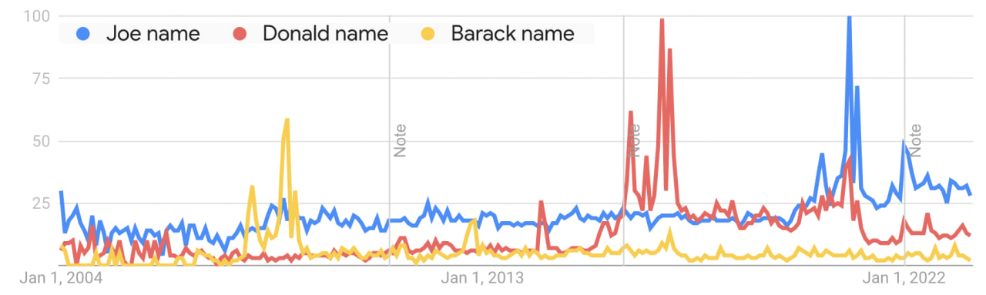

Slide 14

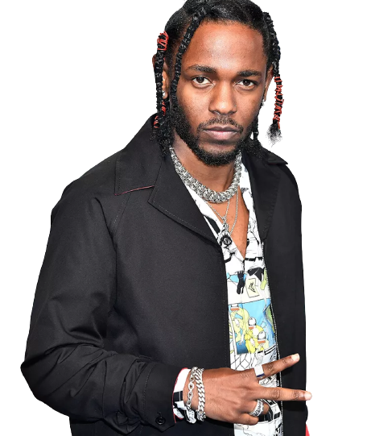
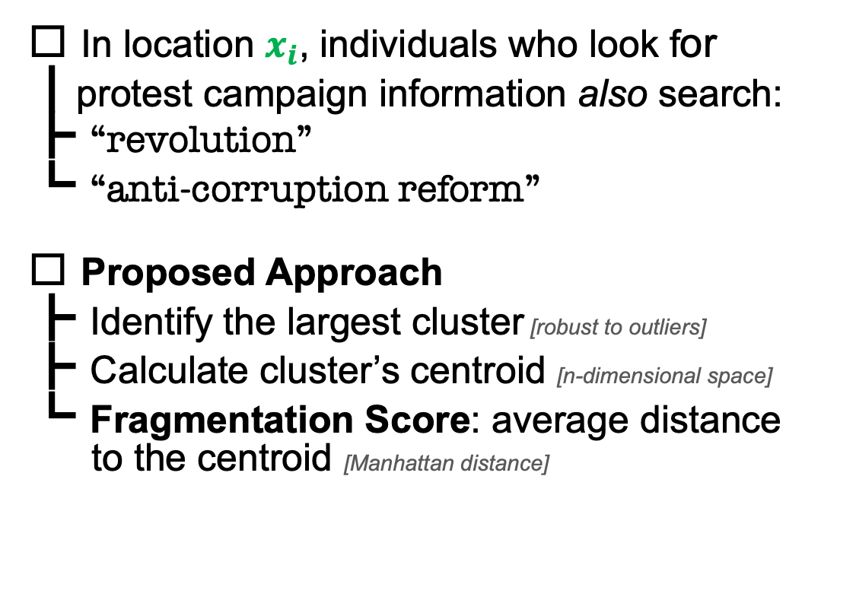
How the heck we get the data?
Old School
☐ In location $x_{i}$, individuals who look for
┃protest campaign information also search:
┣ “revolution”
┗ “anti-corruption reform”
☐ Proposed Approach
┣ Identify the largest cluster [robust to outliers]
┣ Calculate cluster’s centroid [n-dimensional space]
┗ Fragmentation Score: average distance
to the centroid [Manhattan distance]
New School
Notes:
How evidence can inform the theory

Slide 15
How the heck we get the data?
Old School
☐ In location $x_{i}$, individuals who look for
┃protest campaign information also search:
┣ “revolution”
┗ “anti-corruption reform”
☐ Proposed Approach
┣ Identify the largest cluster [robust to outliers]
┣ Calculate cluster’s centroid [n-dimensional space]
┗ Fragmentation Score: average distance
to the centroid [Manhattan distance]
New School
Notes:
How evidence can inform the theory

Slide 16
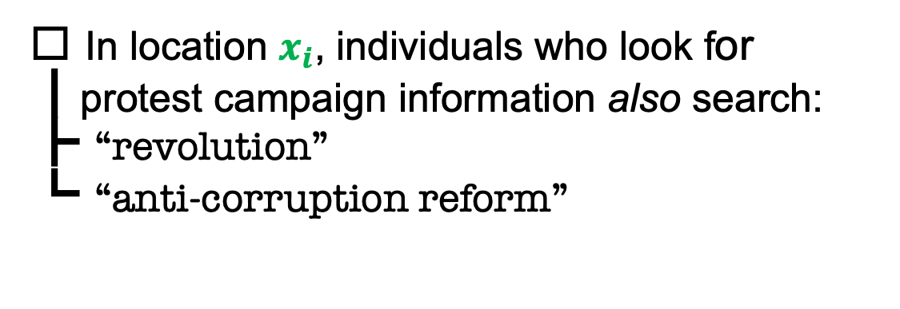
Theory
☐ In location $x_{i}$, individuals who look for
┃protest campaign information also search:
┣ “revolution”
┗ “anti-corruption reform”
Notes:
How evidence can inform the theory

Slide 17
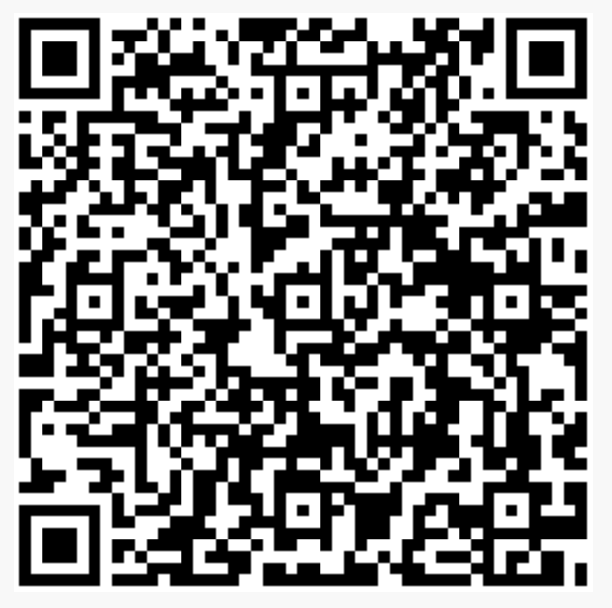
Useful Tools by BellingCat

Slide 18
This Paper
☐ Initial Research Questions
┣ Does lack of unified agenda among protesters reduce
┃ chances of campaign’s success? [Protest Fragmentation Hypothesis]
┗ Do scholars mistakenly categorize de-facto separate campaigns
as a single entity? [“Under The Same Flag” Hypothesis]
☐ Current Goal: Method to estimate campaign fragmentation*
☐ Desired Properties
┣ Behavior-based measure: media reports, surveys, expert opinions
┣ Explicit interpretation: Likert scale, composite measures [Polity IV]
┗ Comparability: cross-country / cross-campaign comparison
Not this paper!
* Campaign Fragmentation – variation in the goals of a protest campaign among protesters

Slide 19
Focus
☐ Sub-national differences in the demand for
┃ information related to a protest campaign
┗ Assumption: High variation ⟿ High protest fragmentation
☐ Correlated behaviors
┗ Key idea: Individuals who look for the same information related to a protest
campaign share similar views regarding the goals of this campaign
☐ Implementation
┣ Input data: Search queries (Google Trends)
┗ Key feature: Ability to identify other search queries individuals conduct
when they seek for protest-campaign information

Slide 20
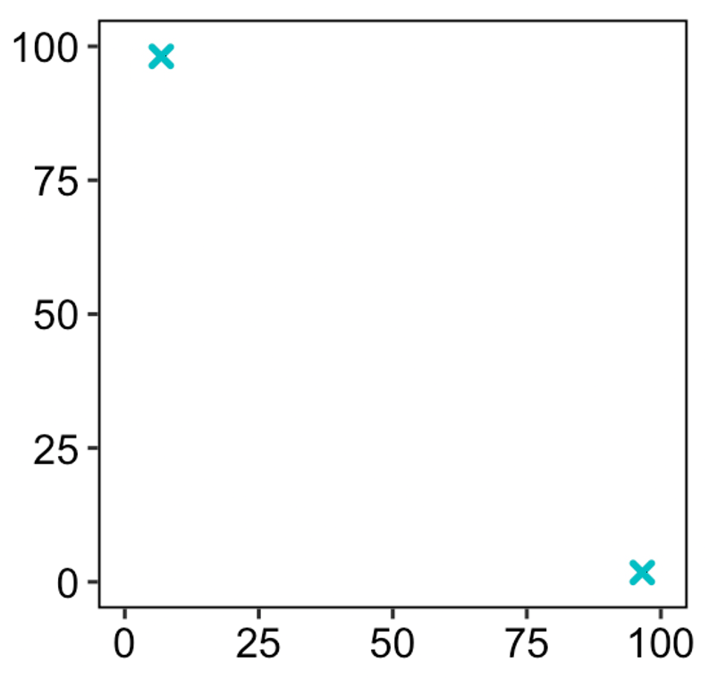
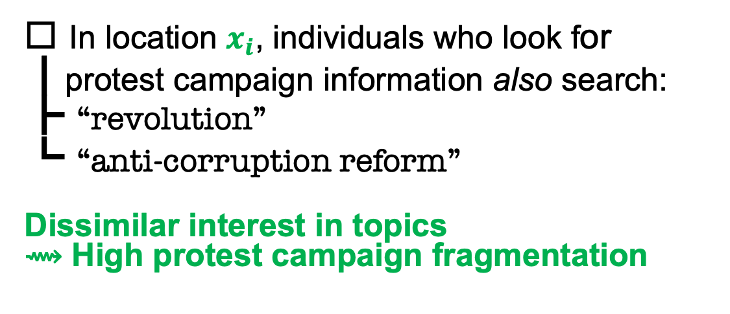
Theory
Case 2: High Fragmentation
☐ In location $x_{i}$, individuals who look for
┃protest campaign information also search:
┣ “revolution”
┗ “anti-corruption reform”
Dissimilar interest in topics
⟿ High protest campaign fragmentation
anti-corruption reform
revolution
Notes:
How evidence can inform the theory

Slide 21
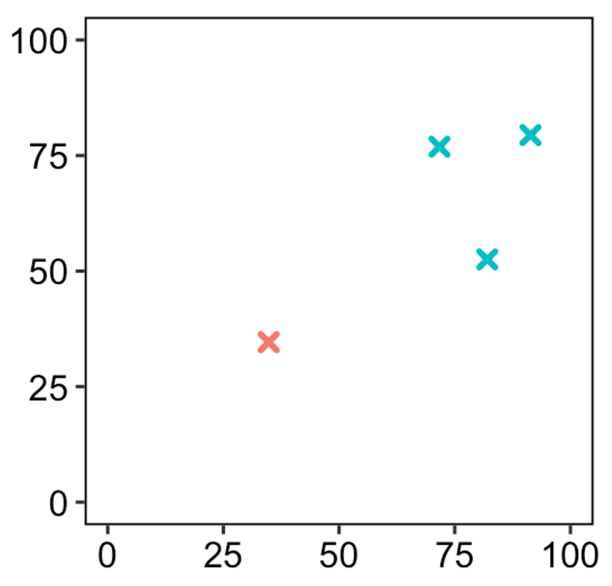
Theory
Case 3: Multiple Locations
☐ In location $x_{i}$, individuals who look for
┃protest campaign information also search:
┣ “revolution”
┗ “anti-corruption reform”
anti-corruption reform
revolution
Notes:
How evidence can inform the theory

Slide 22
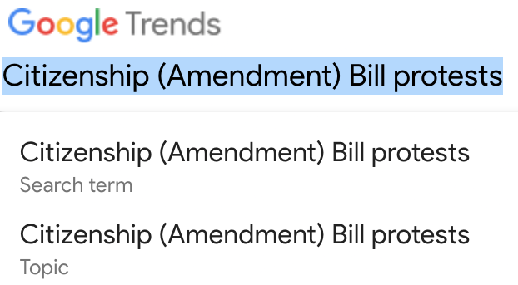
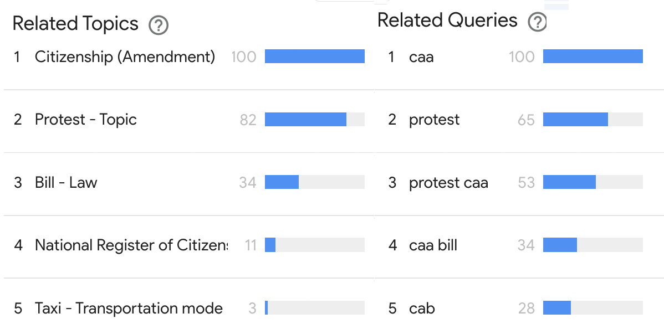
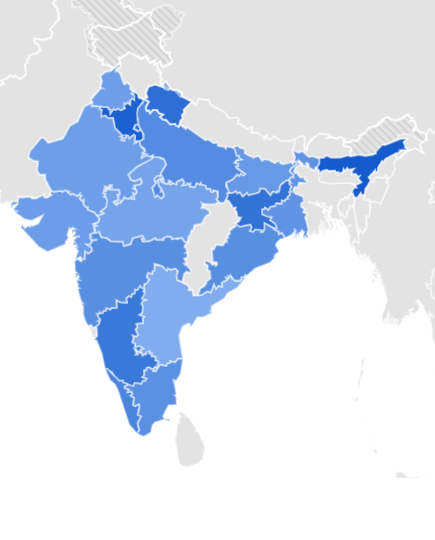
Implementation with G-Trends
Example: Citizenship Amendment Act protests (India, 2019)
☐ Google trends
┣ Score [0-100] based on the volume of search queries
┣ Provides data for separate queries and queries aggregated into topics
┣ Identifies queries / topics correlated with the initial query / topic
┗ Subnational level data
Notes:
How evidence can inform the theory

Slide 23
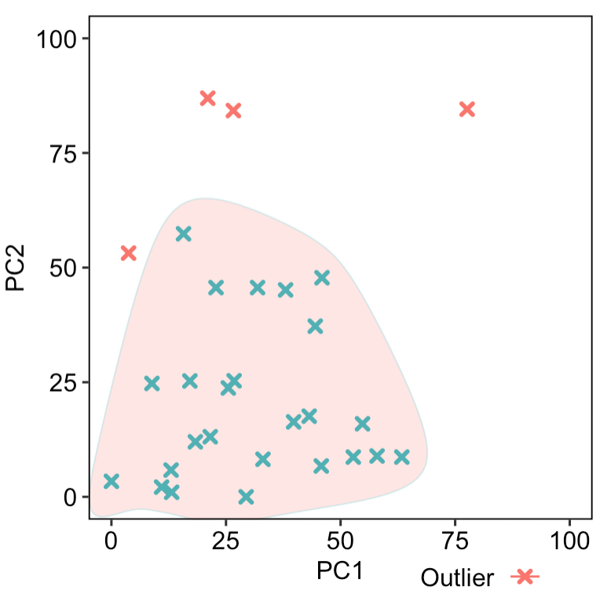
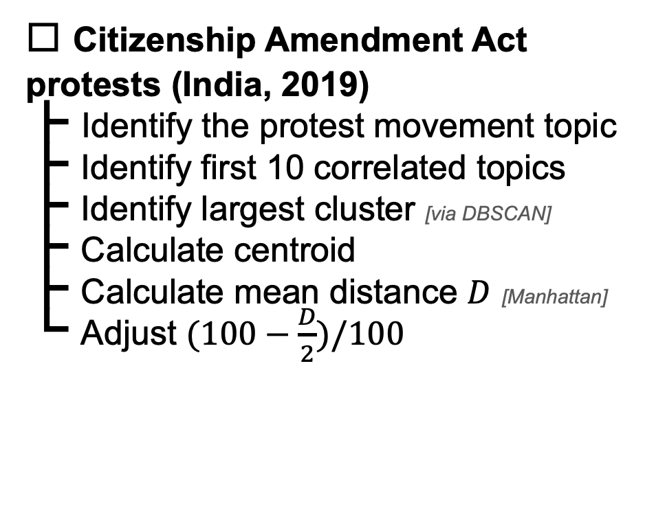
Implementation with G-Trends
Example: Citizenship Amendment Act protests (India, 2019)
☐ Citizenship Amendment Act protests (India, 2019)
┣ Identify the protest movement topic
┣ Identify first 10 correlated topics
┣ Identify largest cluster [via DBSCAN]
┣ Calculate centroid
┣ Calculate mean distance $D$ [Manhattan]
┗ Adjust $(100−\frac{D}{2})/100$
Fragmentation Score = 0.6
* Principal Components are used for illustration purposes
Notes:
How evidence can inform the theory

Slide 24
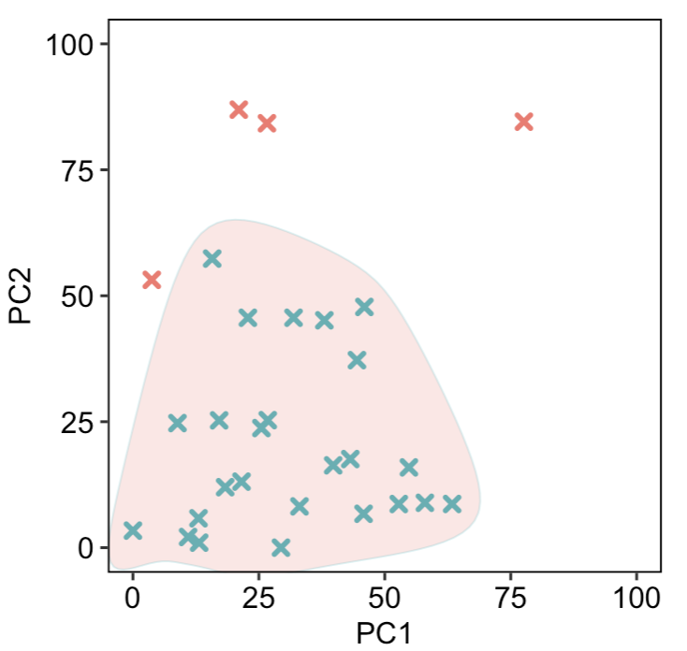
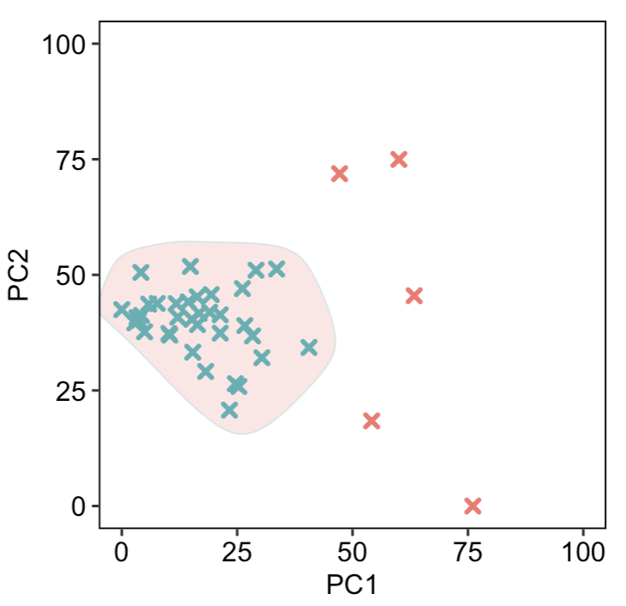
Comparison India-2019 VS US-2017
F-score = 0.6
F-score = 0.92
Citizenship Amendment Act protests (India, 2019)
Women’s March (US, 2017)
Notes:
How evidence can inform the theory

Slide 25
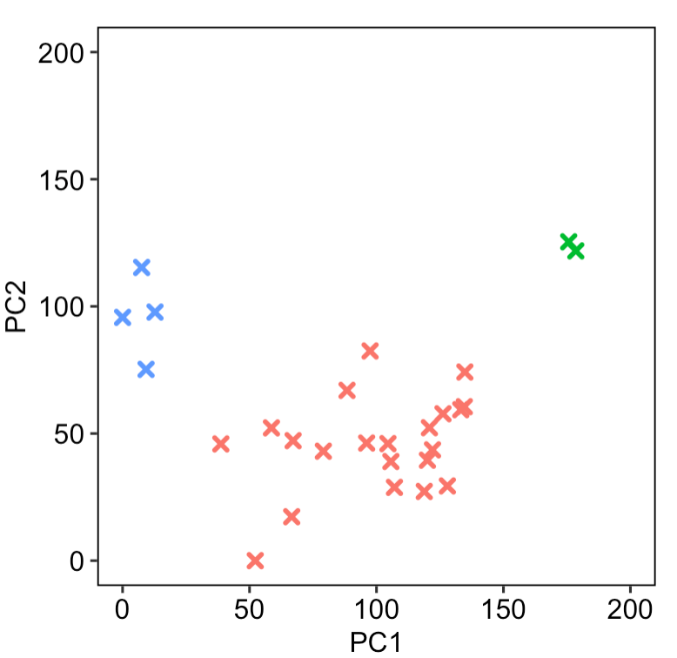
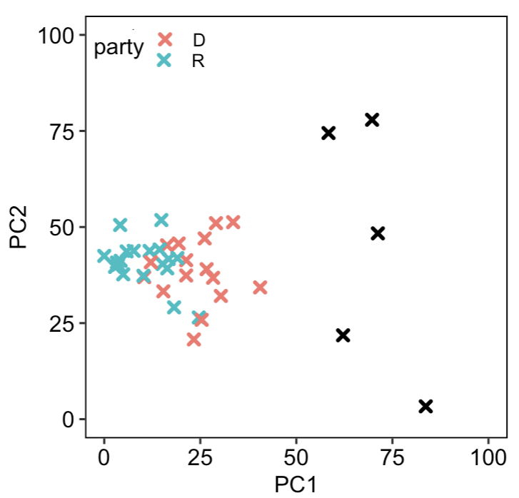
Validity Check Potentially Important Variables
F-score = 0.92
Russia-backed
regions
Former Polish regions
Ukraine EuroMaidan
(Ukraine, 2013-14)
Women’s March (US, 2017)
Notes:
How evidence can inform the theory

Slide 26

Feedback, please
Thank you!
☐ Next steps
┣ Robustness: ☐ How does the F-score change depending
┃ on the number of included correlated queries?
┃ ☐ Alternative clustering
┗ Correlation with closely-related measures: NAVCO [# of organizations, vertical/horizontal communication]
☐ Does it make sense to …
┣ Adjustment: Adjust for the region population / internet users?
┗ Multiple clusters: should we calculate F-score separately for each?

